Slide 1
Stormwater Awareness Training
Virginia Tech Facilities Services – Site & Infrastructure Development (SID)
Chuck Dietz – Stormwater Compliance Manager
Jessica Slagle– ESC/SWM Program Administrator
Katelyn Kast – MS4 Program Administrator

Slide 2
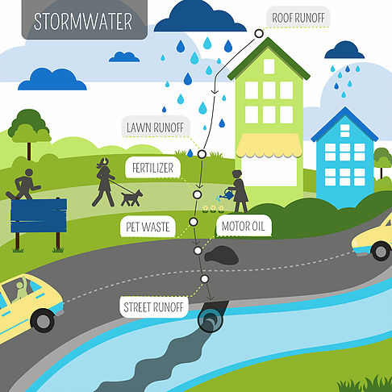
Stormwater Runoff
Where does runoff come from? rainfall and snowmelt events
Where does runoff go? absorbed by natural ground cover and filtered by soil and plants
However…urbanized areas with impervious surfaces (like streets and buildings) prevent this natural absorption and filtration
As rainwater flows over impervious surfaces, the runoff accumulates debris, chemicals, sediment, and other pollutants
Notes:
Stormwater runoff is a naturally occurring event generated by rain events and melting snow. As water flows over the ground, it is absorbed by natural ground cover and is filtered by soil and plants. However, in urbanized areas with impervious surfaces like streets and buildings, the water is unable to percolate into the soil and it picks up chemicals, sediment, and debris as it travels across impervious surfaces into storm drains. Water from storm drains goes directly into local waterways without being treated and can adversely affect our local water quality.

Slide 3
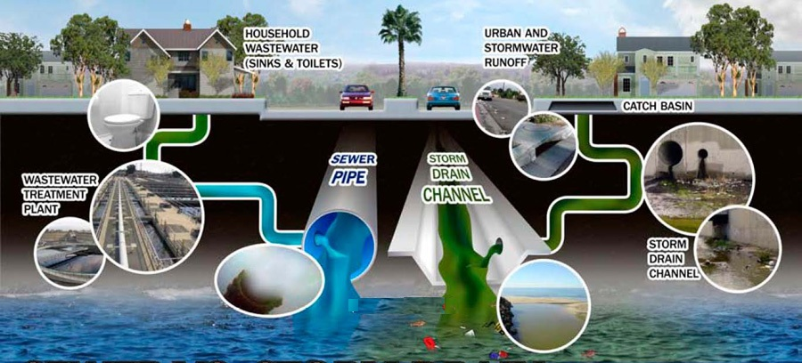
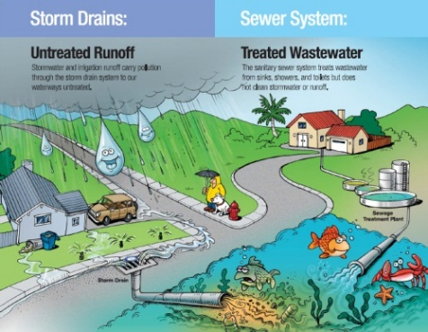
What is an MS4?
Municipal Separate Storm Sewer System (MS4)
Comprised of two separate systems:
Storm Sewer: Releases untreated water into waterways
Sanitary Sewer: Directs water to waste water treatment plant where the water gets treated
Notes:
An MS4 is a Municipal Separate Storm Sewer System. Virginia Tech has an MS4. This means there is a piping system for stormwater that is separate from the piping system for the sanitary sewer. The sanitary system carries water from drains like sinks and toilets. Water from our homes directs to a sewage treatment plant where it is treated and tested before being released back into local waterways. The stormwater system, however, directs water from roads, sidewalks, and buildings into local waterways; this water is not treated.

Slide 4
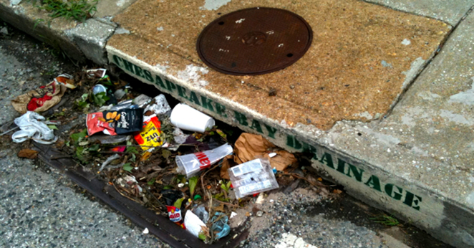
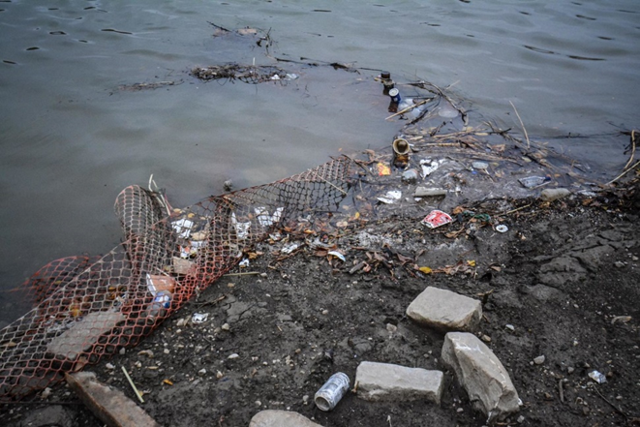
How Does Stormwater Affect You?
Streams and creeks feed into rivers, lakes, and eventually oceans; causing pollution
The effects of pollution limit our ability to:
Boat
Fish
Swim
Maintain desired aesthetics
Notes:
The simple tips covered in this training will help reduce pollution and keep Blacksburg waterways healthy.

Slide 5
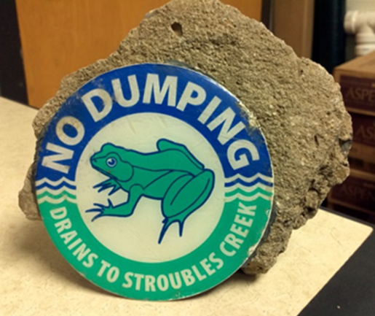
No Dumping
What classifies as “dumping”? disposing of chemicals and/or solid waste down a storm drain
Dumping is prohibited because it has the potential to harm aquatic life
Notes:
“Dumping” is putting something down a storm drain that is not stormwater. Aside from a few permitted non-stormwater discharges, it is strictly prohibited to dispose of chemicals and solid waste down storm drains. Dumping wastes down the storm drains on the Virginia Tech campus means that waste will reach local waterways.

Slide 6
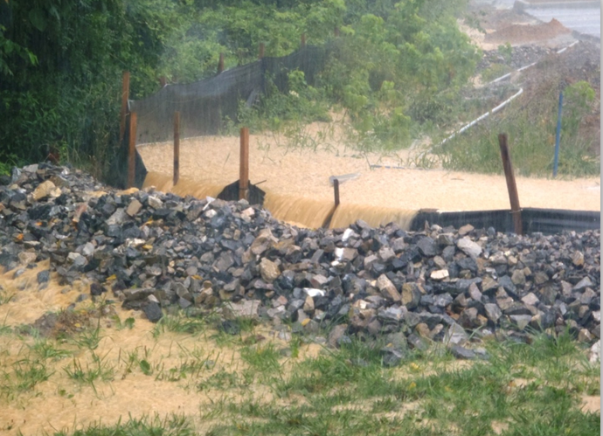
Sediment
What makes sediment harmful?
Pollutants stick to sediment and are washed into local waterways
Sediment impairs culverts and reservoirs
Sediment harms aquatic life
Stroubles Creek (Virginia Tech’s main waterway) is impaired by the EPA due to an overload of sediment
Notes:
Sediment is one of the biggest threats to water quality and is considered the main contributing pollutant that impairs Stroubles Creek in Blacksburg, VA. When sediment is washed into storm drains, it brings with it additional pollutants like phosphorous which adhere to sediment particles. Sediment can block drains and cause backups, inhibit the function of reservoirs and culverts, and, when it is released into local waterways, harm aquatic life and damages the ecosystem. Finally, sediment increases the cost of water treatment.
EPA- Environmental Protection Agency

Slide 7
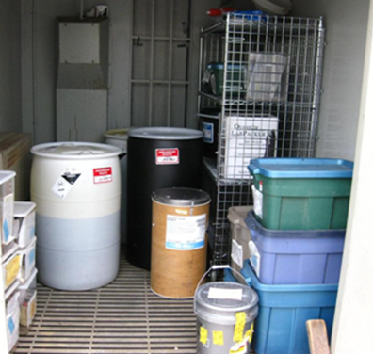
Spill Prevention and Chemical Storage
First-in, First-out system: use the oldest chemicals first
Store materials inside – to prevent rainwater from washing pollutants into storm drains
Ensure that lids and covers are secure and check containers for damage
Ensure that all containers are properly labeled
Use funnels and plastic sheeting to protect against spills
Do not use chemicals near waterways or storm drains
Notes:
Spill prevention is an important economic and environmental concern. A first-in, first-out system will help to avoid the degradation of older chemicals and their containers. Properly store materials inside or undercover to prevent anything from being washed into storm drains. Always make sure that lids and covers are securely placed on containers and periodically check these containers for damages or leaks. Transfer contents to an undamaged container if necessary. When transferring materials, use plastic sheeting and funnels to avoid any spills on the ground. Finally, do not to use any harmful chemicals near water or storm drains.
First in, First out System: use items in order from oldest to newest. This ensures that items are not over-ordered and are used before the expiration date and/or rate of deterioration.
NOTE: When you have exceeded the expiration date or have no further use of a chemical, contact EHS to have the chemicals removed for proper disposal.

Slide 8
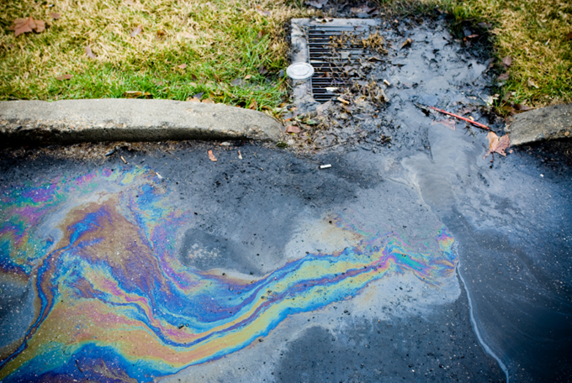
Spill Cleanup
For ALL chemical spills:
Call Environmental Health & Safety (EHS) immediately: (540) 231-3600
Block surrounding drains
Secure area with precautionary signs
Do not try to wash away or dispose of chemicals
Notes:
In the event of any sort of chemical spill, immediately contact EHS at (540) 231-3600 to receive further clean-up instructions. Block any drains near the spill and secure the area with precautionary signs. Do not try to clean up or wash away the spill without professional assistance.

Slide 9
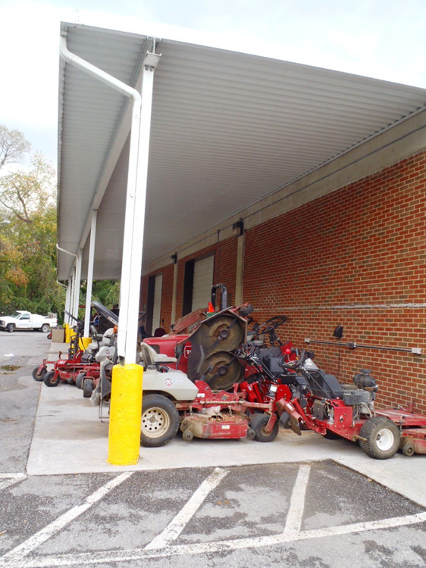
Vehicles and Equipment
What to do:
Keep equipment under covered areas
Wash equipment on permeable surfaces or designated wash areas
Check vehicles and equipment for leaks
Recycle oil, antifreeze, and other vehicle fluids. When waste containers are full, notify EHS
Washwater from truck chutes, hand mixers, and equipment must be cleaned in a designated concrete washout area
Notes:
Keeping your vehicles and equipment under covered areas will reduce pollutants from being picked up by rainfall events. Wash vehicles in a designated washing area. If this is not possible, wash on permeable surfaces so that the water can be filtered into the ground. Periodically check for leaks and use drip pans to contain any leaks. Always be sure to recycle oil, antifreeze, and other recyclable fluids. Do not throw these fluids away, dump them on the ground, or put them down any drains. Always try to reduce the amount of water and cleaning products used. Use drip pans to contain leaks when needed.
Concrete washwater is toxic to aquatic life and can contaminate drinking water. All concrete waste and washwater should be returned for disposal at the concrete batch plant or disposed of at an on-site concrete washout area. There are prefabricated and self-installed washout designs.

Slide 10
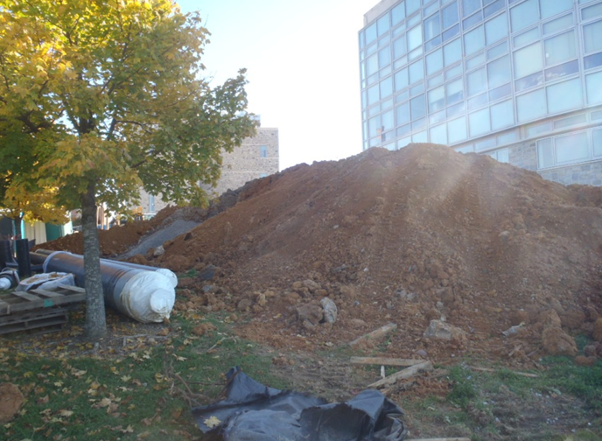
Bulk Storage Areas
How do you keep storage areas protected from stormwater runoff?
Store away from inlets, waterways, and drainage courses
Store indoors or under covered areas
Use perimeter controls and stabilization measures for soil stockpiles
Place bagged material on pallets and undercover
Examples of bulk storage areas/stockpiles include: salt storage, topsoil, mulch, etc.
Examples of perimeter controls and stabilization measures include: silt fence, inlet protection, etc.
Notes:
Protect against air and stormwater pollution by properly storing and securing bulk storage areas and stockpiles. Perimeter controls and stabilization measures should be considered for topsoil stockpiles.
Please contact Facilities Services – Site & Infrastructure Development with questions or for further information.

Slide 11
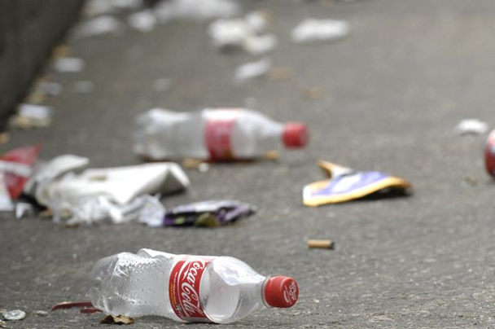
Litter
Easy tips to help avoid accumulating litter:
Throw away all trash in the proper receptacle
Recycle
Put cigarette butts in an ash tray or designated receptacle
Leached chemicals and toxic residue from cigarettes are harmful to wildlife and waterways
Sweep regularly
Keep dumpster lids closed and rainwater/liquids out of dumpsters
Notes:
Litter can block the stormwater drainage systems causing flooding and pollution in the water. Be sure to always throw away your trash in the proper receptacle. Whenever possible, recycle materials. Always put cigarette butts in an ash tray or designated receptacle. Cigarettes are the most littered product in the United States and are incredibly harmful to wildlife and water. Sweep work areas regularly to avoid any build-up of debris.

Slide 12
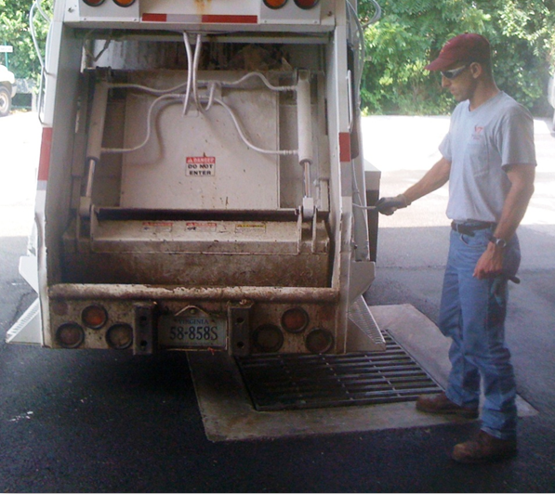
Waste Disposal
For ANY waste:
Do not dump on the ground, down storm drains, or into waterways
Dispose of wastewater in a drain that leads to the sanitary sewer (Example: inlet behind Sterrett Facilities Complex [pictured right])
For NON-HAZARDOUS waste:
Dispose of in the proper receptacle
For HAZARDOUS waste:
Call EHS for proper removal
Notes:
Do not dump any waste on the ground, down drains, or into waterways. Instead, dispose of waste in the proper waste receptacle as long as it is non-hazardous. Call EHS to remove any hazardous waste. Use sanitary drains to dispose of waste water. Always be sure to keep dumpster lids closed to keep rainwater out. Do not discharge municipal vehicle wash water into the MS4. Best management practices must be implemented when discharging water pumped from utility construction and maintenance activities.

Slide 13
Landscaping
Do not mow before a rainfall event, and avoid mowing your grass shorter than 3 inches
Avoid blowing or piling grass/yard waste near inlets or water bodies
Notes:
Do not mow before any forecasted rain and do not mow the grass below 3 inches to assist in the filtration of stormwater. Compost any landscaping waste and keep it away from stormwater inlets. If landscaping debris enters the stormwater system, the decomposing material will lead to the eutrophication of lakes and ponds causing algal blooms and fish kills.

Slide 14
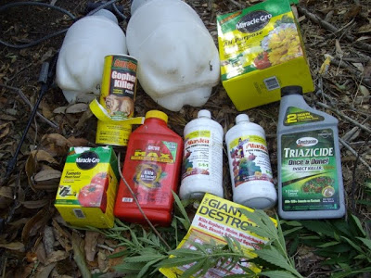
Fertilizers and Pesticides
Fertilizers must be applied in accordance with manufacturer’s recommendations
Pesticides must be applied by a certified pesticide applicator
Notes:
Certified pesticide applicator – Individuals must obtain a license through Virginia Department of Agriculture and Consumer Services (VDACS) to become an applicator

Slide 15
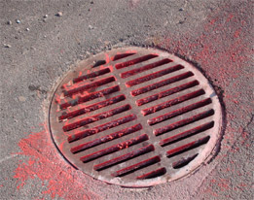
Paint
How to properly use paint:
Always use a drop cloth
Clean brushes and tools in a sanitary sink
When using non-water based paints that must be cleaned with solvent, dispose of the solvent in the proper manner
Notes:
When painting, always be sure to use a drop cloth to protect against spills. Properly clean brushes and tools in a sanitary sink. If you are using a non-water based paint, clean materials with solvents, which must be collected and disposed of in the proper manner. Do not dispose of solvents down a sanitary drain or a storm drain.

Slide 16
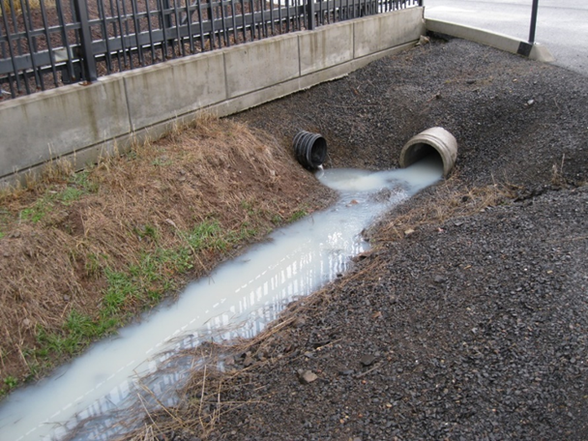
Illicit Discharges
What is an illicit discharge? Any discharge to an MS4 that is not composed entirely of stormwater
Indicators:
suds
oil sheen
sewage
discoloration
strange odors
Notes:
An illicit discharge is anything that is not composed completely of stormwater. Around campus, look for any indicators of an illicit discharge in local waterways, around storm drains, and around storm inlets. Please report incidences to EHS at (540) 321-3600 or online at www.ehss.vt.edu/report_issue.

Slide 17
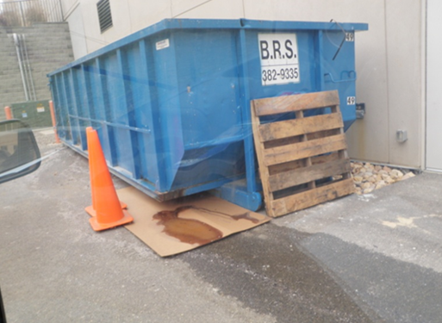
Reporting Illicit Discharges
Report all spills to Environmental Health and Safety (EHS)
To report dumping, illicit discharges, or other stormwater violations call EHS at (540) 231-3600 or visit www.ehss.vt.edu/report_issue

Slide 18
Contact Information:
Virginia Tech Facilities Services Site & Infrastructure Development
69 Sterrett Facilities Complex (0129)
Blacksburg, VA 24061
Phone: 540-231-6882
Website: www.sid.vt.edu
Email: stormwater@vt.edu

